Slide 1
Graph-based Dynamic Route Planning for Collective Customer Matching

Slide 2
Introduction
Knowledge graph: utilize big data and ‘thick’ data
Knowledge graph based delivery service
takes multiple orders
identifies servers based on customer preferences, locations, and historical order data
Goal: assign drivers to deliveries
maximize deliveries
minimize cost of deliveries
Notes:
We use a knowledge graph to return restaurants that satisfy each customers requirements
With these restaurants, we need to assign drivers to maximize the number of deliveries while still minimizing cost

Slide 3
Problem Formulation
P(D_{i} , C_{j}) | the shortest path from D_{i} to C_{j} while still visiting all restaurants for C_{j}
∆( C_{j} ) | deadline of customer C_{j}
γ(D_{i} , C_{j}) | cost of D_{i} in reference to C_{j}
Cost γ(D_{i} , C_{j}) - multiple formulations
maximize income while minimizing cost, ensuring freshness, or penalizing missed deadlines
Notes:
Those are just some terms we define now to be used later
Cost can be set up multiple ways depending on how you want your drivers matched
-> maximizing income would be to prioritize customers paying more or really just get the monetary net gain
-> ensuring freshness would be adjusting cost to ensure that the food is delivered in a way that orders stay fresh (the order of restaurants)
-> penalizing missed deadlines would be adjusting the cost to be larger if its deadline is missed

Slide 4
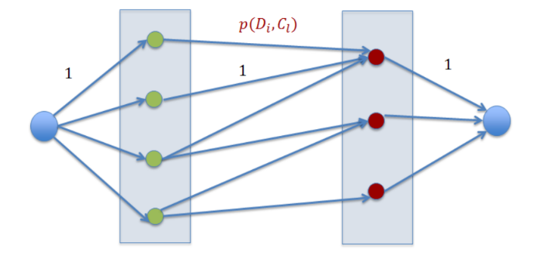
Single Matching Algorithm
Pruning
Normally, |C| × |D| distance calculations are required
For customer C_{j}: neighbor search with radius ∆_{j} − P(R_{k}, C_{j}), for restaurant R_{k} ∈ Rests(C_{j}) [necessary condition]
Matching
Set up drivers and customers on a bipartite graph
Set edges from drivers (D_{i}) to customers (C_{j}) that exists with cost γ(D_{i} , C_{j}) if and only if P(D_{i} , C_{j} ) ≤ ∆(C_{j} )
Notes:
Prune using near neighbor search to reduce the required distance computations
Set up as seen in the graph with green dots being drivers and red dots being customers

Slide 5
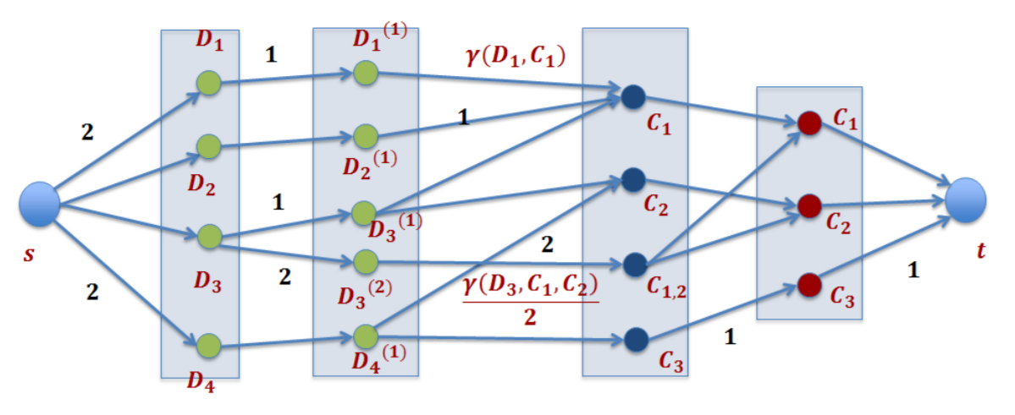
Double Matching Algorithm
Pruning
Normally, |C| × |C| × |D| distance calculations required for double matching
Single - customer C_{j}: neighbor search with radius ∆_{j} − P(R_{k}, C_{j}), for restaurant R_{k} ∈ Rests(C_{j})
Double - customers C_{j,k}: for C_{k} in near neighbor with radius ∆_{j}, driver D_{i} can deliver to C_{j} and C_{k}, and satisfies P(D_{i}, C_{j}, C_{k}) < ∆_{k} , ∆_{j}
Matching
Use a network flow graph and set single and double edges
After min-cost max-flow is run, convert flow into driver assignment
Notes:
Prune single orders the same as before
Double orders are pruned by if they can make both ck and cj if ck lies within radius cj of deltaj and if delivering both doesn’t violate either deadline, then check for each driver (could be done with near neighbor of radius of smaller delta)
After min cost max flow is ran, run an algorithm to fix flow and asign drivers

Slide 6
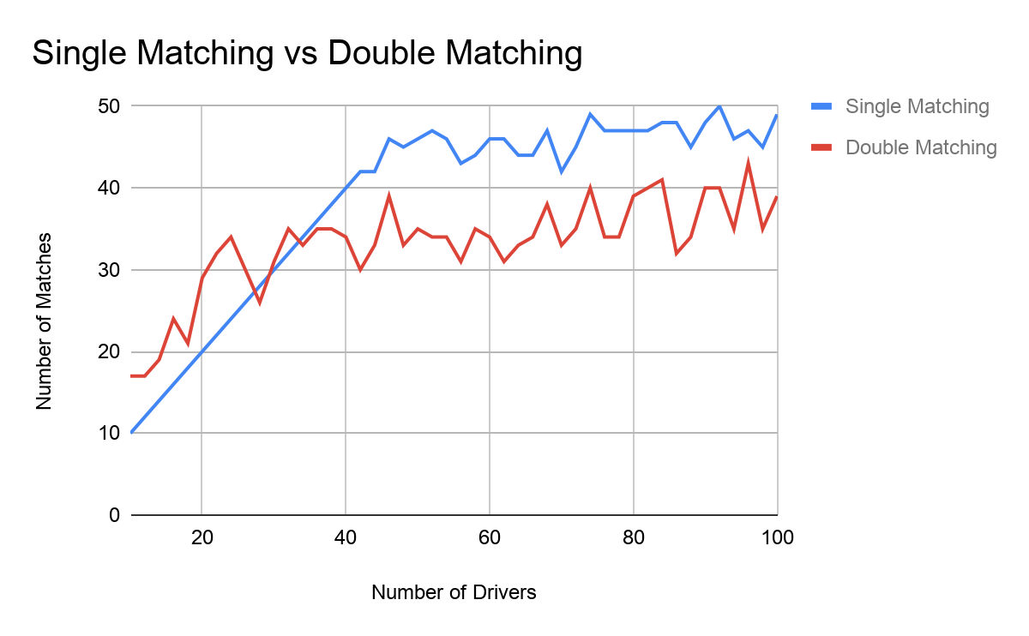
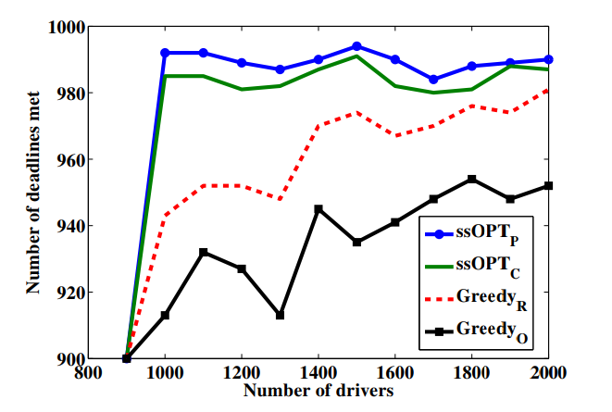
Main Theorem + Results
The double matching algorithm will satisfy at least 4/9 of the deadlines compared to the optimal with at most double the cost
Satisfies at least ⅔ of the deadline of the optimal if cost is not considered
Notes:
small number of drivers: use multiple-customer matching
large number of drivers: use single-customer matching

Slide 7
Delivery Service Platform
A GUI for collective customer matching with features for
Restaurants: analyze sales, perform “what if” analysis
Food delivery customers: perform assignments in real time, understand density of demands
Cloud enabled so it can use parallelism to significantly decrease execution time
Users can adjust the time interval between runs of the matching algorithm
Notes:
Parallelism is used because 99.5% of the execution time is from distance calculations.
Adjusting the time interval between runs of the matching algorithm allows for

Slide 8
Demo

Slide 9
Problem Formulation
Part 1
Our goal is to maximize the number of deadlines while minimizing the cost
For single driver-single company, we use a min-cost max-matching algorithm on a bipartite graph
For single driver-multiple companies, we use a min-cost max-flow on a flow network

